Slide 1
Enhancing small objects' visibility.
chatGPT, Dall-E and Robert Haase

Slide 2
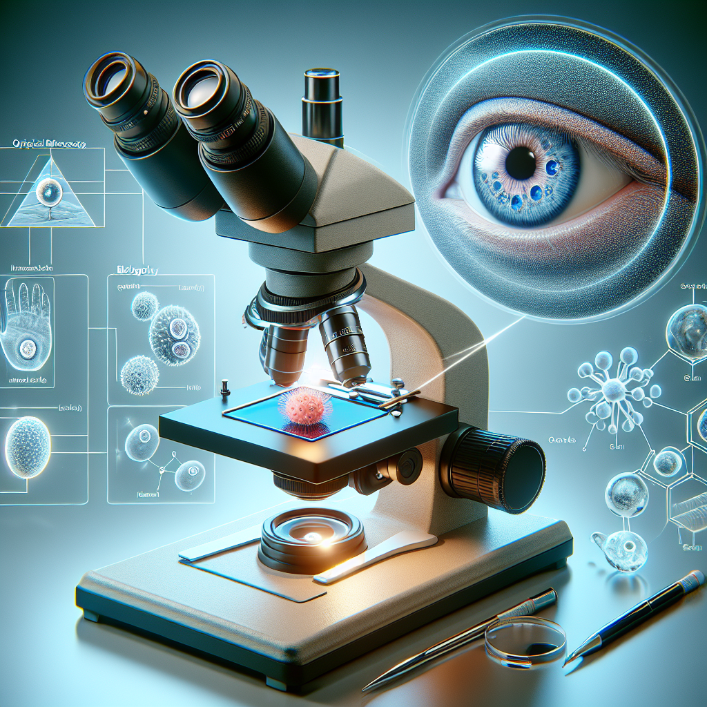
Enlarging small objects with light.
Optical microscopy, also known as light microscopy, is a technique used to enlarge images of small objects using visible light. This type of microscopy is fundamental in biological research, material science, and various fields of study to observe details that are too small to be seen with the naked eye.

Slide 3
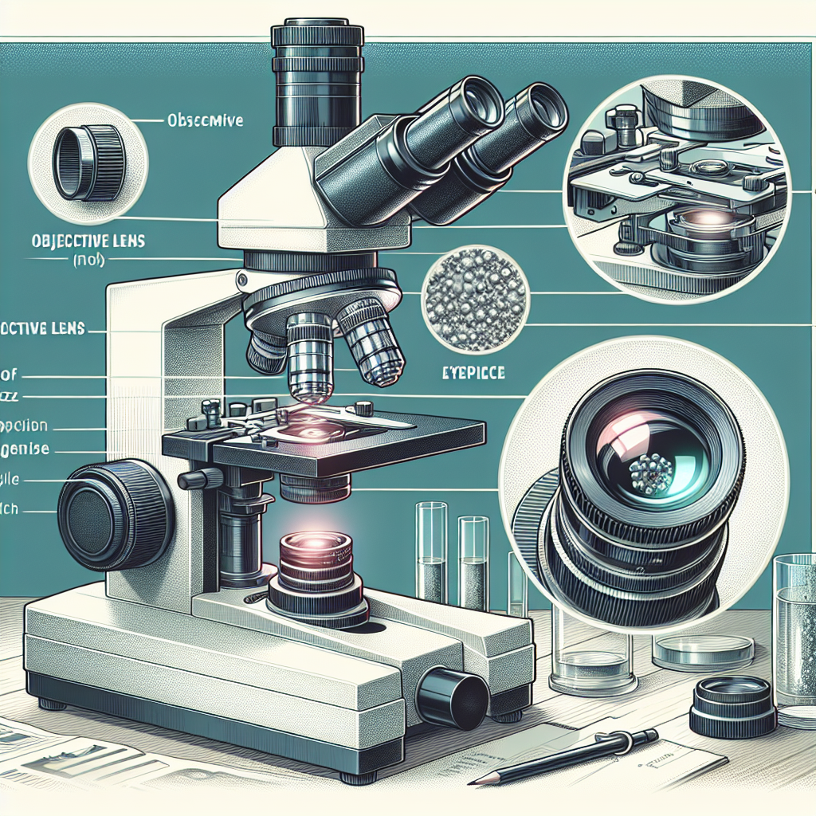
Lens system magnifies specimens.
The basic component of an optical microscope is the lens system, which includes the objective lens and the eyepiece. The objective lens, positioned close to the specimen, creates an enlarged image. The eyepiece further magnifies this image for the observer. Modern microscopes often have multiple objective lenses, allowing for varying levels of magnification.

Slide 4
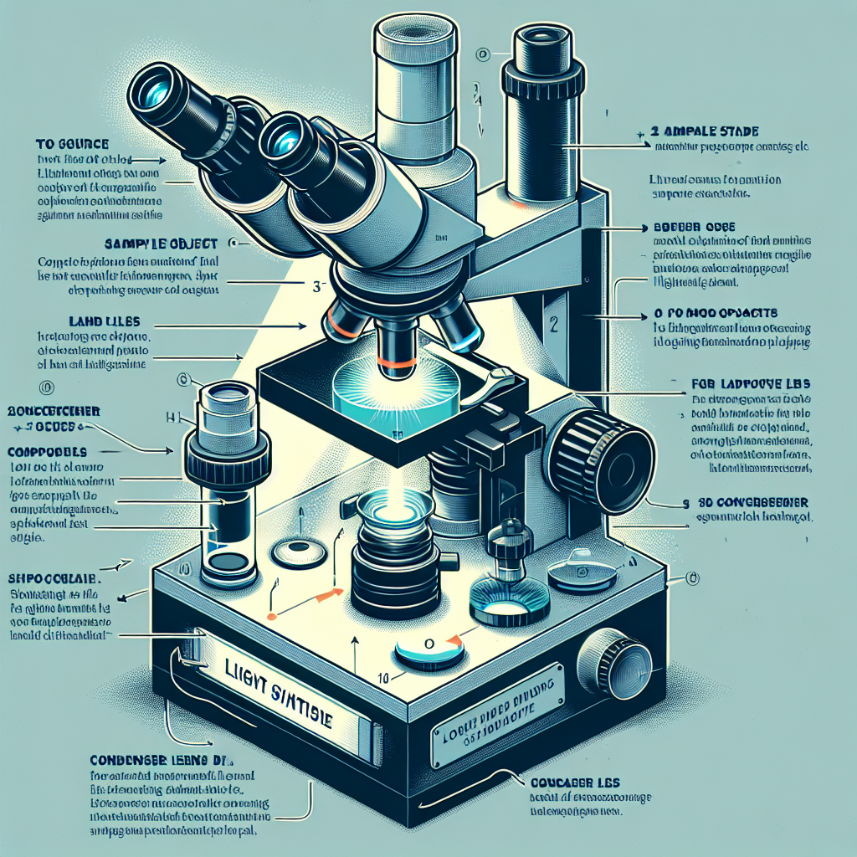
Illumination essential for specimen clarity.
Proper illumination of the specimen is crucial for clear visualization. This is typically achieved through a light source beneath the sample stage, directed upwards, and sometimes, for more opaque objects, above the stage directed downwards. The condenser, another lens system below the stage, focuses the light onto the specimen, enhancing image contrast and clarity.

Slide 5
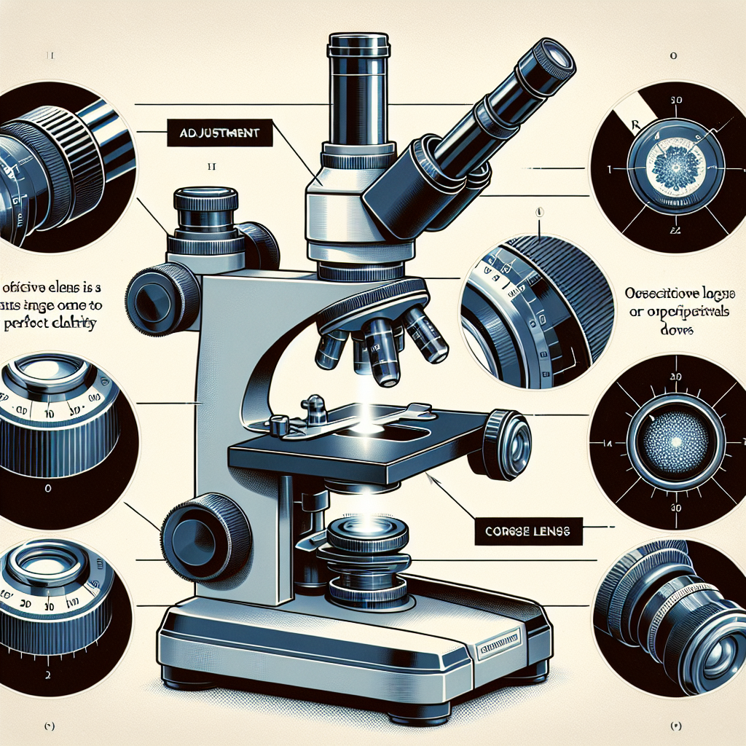
Adjusting focus, vital in microscopy.
Adjusting the focus is a vital step in microscopy. Fine and coarse adjustment knobs are used to bring the specimen into sharp focus at different magnifications. Correct focusing involves moving the stage or the objective lens until the clearest possible image is obtained.

Slide 6
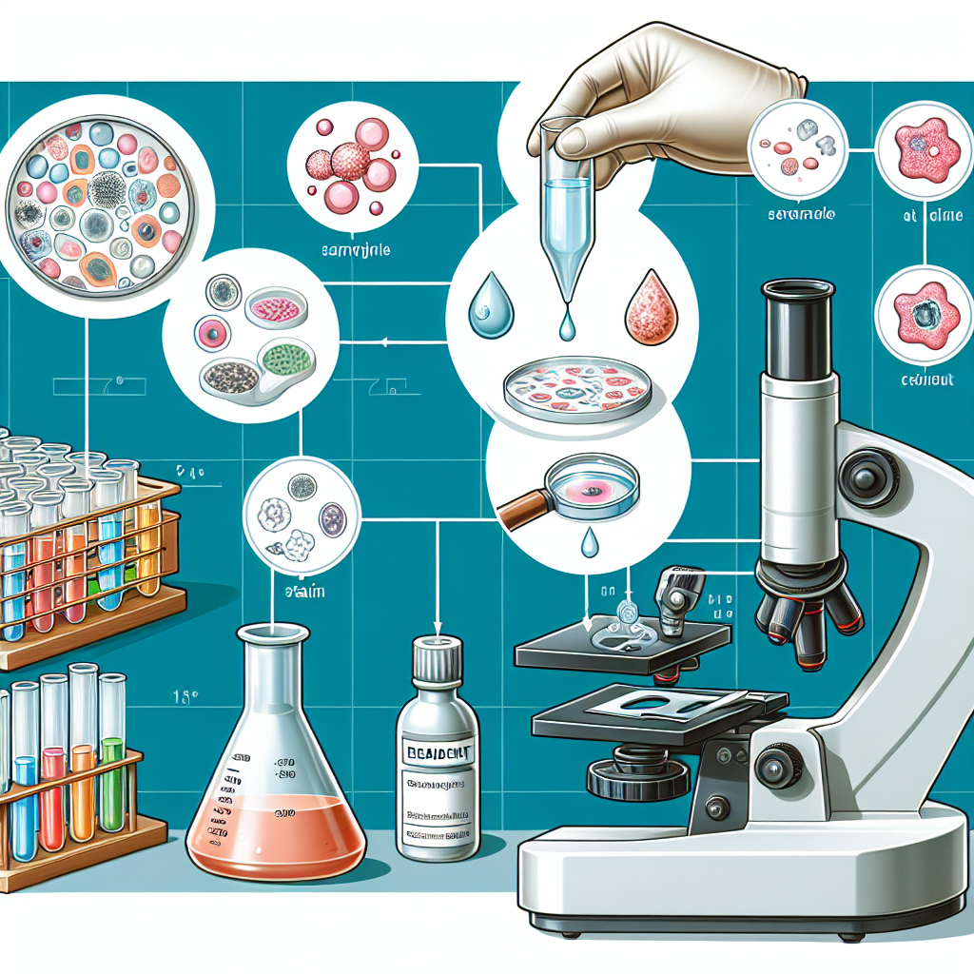
Sample preparation enhances visibility.
Sample preparation is another important step, particularly for biological specimens, which may require staining to enhance contrast or to highlight specific cellular components. Stains bind to specific structures within the cell or tissue, making them more visible under the microscope.

Slide 7
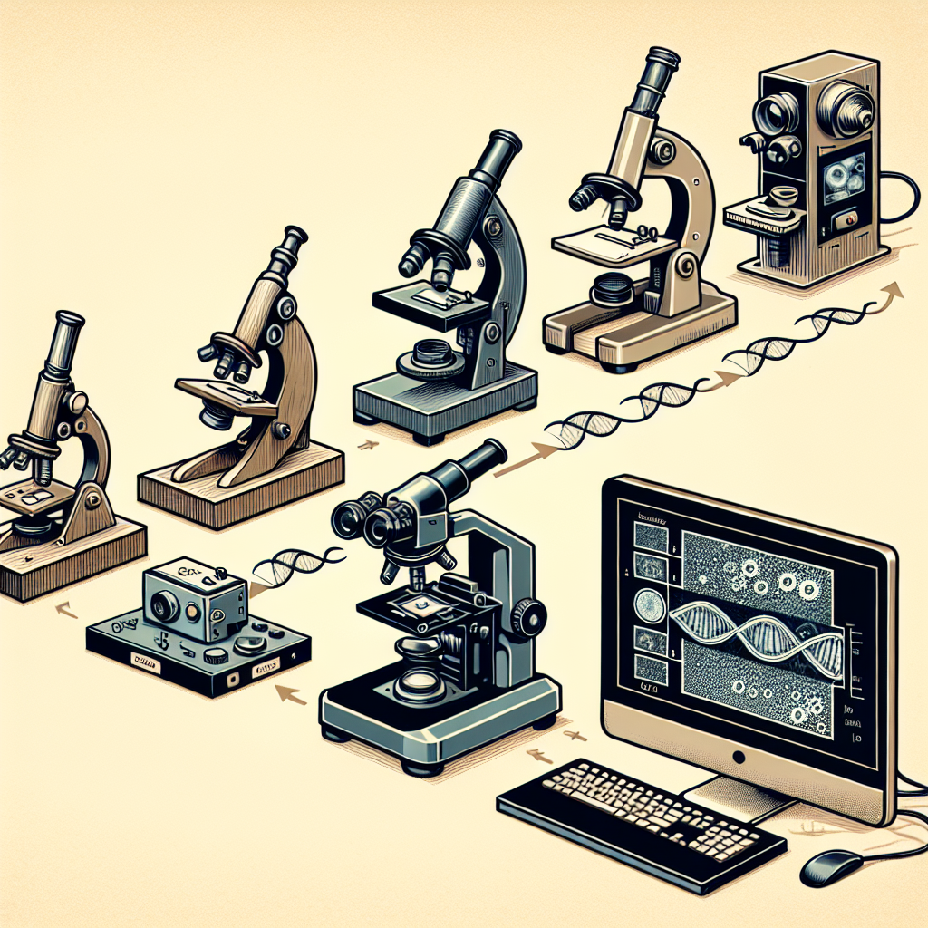
Digital imaging enhances microscopy analysis.
Finally, the development of digital imaging techniques has significantly expanded the capabilities of optical microscopy. Cameras attached to microscopes can capture and store images for further analysis, allowing for detailed documentation and more sophisticated quantitative analysis of the observed specimens.

